Slide 1

Improve Machine Learning Results with Ensemble Learning
CDC Data Science Certificate Program
Notes:
In short, you wouldn’t take the decision directly but will instead consider the opinions of other people as well. Ensemble technique in Machine Learning works on a similar idea.

Slide 2
Agenda
Introduction
Intuition
Stacking
Bagging
An algorithm based on bagging:
a. Random Forest
Boosting
Algorithms based on boosting: a. AdaBoost (Adaptive Boosting) b. Gradient Boosting (GBM) c. XGBoost (eXtreme Gradient Boosting)
Notes:
Revisit #4 random forest

Slide 3
Course objectives
Carry out an essential review of re-sampling methods, bootstrap
Explore the key ensemble methods: bagging, random forests, and boosting
Understanding the idea and usage of Boosting and AdaBoost
Use multiple algorithms to make strong predictive models
Supplement methods with statistical tests, such as ROC
Use the supplied R code to implement ensemble methods

Slide 4
Background Literature Review
Methods discussed in this course are mathematically intensive. Literature is provided for the reader to better understand how the algorithms compute. Please take time to review the papers.
Notes:
References has been uploaded to the CDC portal and github

Slide 5
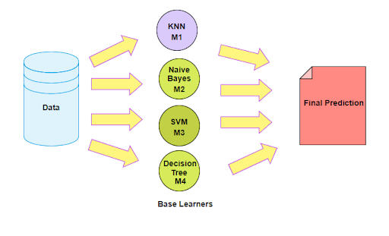
Ensemble learning is a machine learning technique in which the same algorithm is used multiple times, or a group of different algorithms are combined to build a more powerful model. The ensemble is primarily used to improve the performance of the model.

Slide 6
Ensemble Learning:
Combine predictions of multiple learning algorithms → ensemble
Often leads to a better predictive performance than a single learner
Well-suited when small differences in the training data produce very different classifiers (e. g. decision trees)
Drawbacks: increases computation time, reduces interpretability
Reasoning:
Classifiers C₁,...,C_{K} which are independent. i.e., cor(C_{i},C_{j}) = 0
Each has an error probability of P_{i} < 0.5 on the training data
Then an ensemble of classifiers should have an error probability lower than each individual P_{i}

Slide 7
These are the main instanced when you should use ensemble learning:
Wisdom of all
The dataset is too large or too small
Complex (nonlinear) data
High confidence
Decrease Variance and Bias
Notes:
Different models pick up different patterns in data. If we pool all these predictions together, as long as these models are reasonably independent and diverse, the outcomes tend to be better.
2. Ensemble methods tend to sample the data if it’s too small or too large, hence improving accuracy. When data is in non-linear fashion then a single model may underfit. In this case, taking different outputs of different models and combining them according to purpose can improve accuracy.
a. When a dataset is too large and so it cannot be trained by a single model, we can create a small subset of data to train different models. At the end, we can choose the average of all as the final prediction. Similarly, when a dataset is too small to train a single model, we can use bootstrap methods to create random subsamples of data to train the models.
b. Most of the time, a real-world dataset is a nonlinear dataset, where a single model cannot define the class boundary clearly. This is known as underfitting of the model. In such cases, we can use more than one model to train different subsets of the data and average out the result at the end to predict distinct boundaries.
4.When we train multiple classifiers on the training dataset and get mostly correlated output, it ensures a high prediction rate. Consider a case of classification where most of our classifiers predict the same class for an instance; in such cases, interprets ensemble system having high confidence on its decision.
When we train a model with multiple classes and get high correlated output these situations lead the High Confidence.
5. The aggregate opinion of a bunch of models is less noisy than the single opinion of one of the models. Ensemble models combined together in a certain way help decrease the bias.
Bias error is useful to quantify how much on an average are the predicted values different from the actual value.
Variance on the other side quantifies how are the prediction made on same observation different from each other.
The High-bias model under-fits the data. The difference in the predicted and actual is high in both the test and test dataset.
The high-variance model over-fits the data. The difference in the predicted and actual is low in test and high in the test dataset.
The bias-variance tradeoff reveals a fundamental problem in modelling. In order to minimize model risk, we use a combination of feature engineering, model selection, and cross-validation to balance bias and variance.

Slide 8
Bootstrapping: Bootstrap randomly performs row sampling and feature sampling from the dataset to form sample datasets for every model. By bootstrapping, a better overall estimate of the desired quantity can be achieved than simply estimating from the dataset directly.
Notes:
Replacement means that if a row is selected, it is returned to the training dataset for potential re-selection in the same training dataset. This means that a row of data may be selected zero, one, or multiple times for a given training dataset.
Bootstrapping is a statistical method of estimating a quantity of data from original data. We create ‘k’ random samples with replacement from training dataset each of size d, where d < n and n is a number of training points.
After samples of subsets are formed, separate and independent models are trained with those subsets. The final predictions are made by combining the predictions from all the models to build the meta-classifier or regressor.

Slide 9
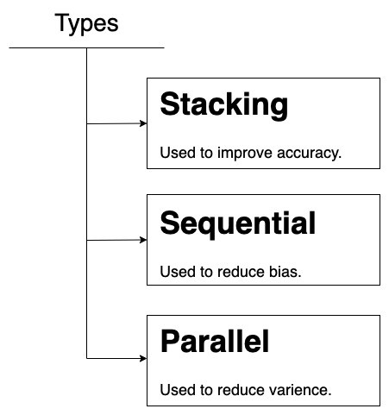
Supervised ensemble machine learning algorithm that finds the optimal combination of a collection of prediction algorithms using a process called stacking.
Boosting is an iterative technique
which adjust the weight of an
observation based on the last classification.
Bagging tries to implement similar learners on small sample populations and then takes a mean of all the predictions. In generalized bagging, you can use different learners on different population. As you can expect this helps us to reduce the variance error.
Notes:
3 main types of ensembles for combining different classifiers
1. Stacking and Blending - Super Learner algorithm (aka Stacking, Stacked Ensembles).
In general, we take the aggregate in the case of regression and maximum voting in the case of classification.
Stacking : This is a very interesting way of combining models. Here we use a learner to combine output from different learners. This can lead to decrease in either bias or variance error depending on the combining learner we use.
2. Sequential / Boosting
Boosting (originally called hypothesis boosting) refers to any Ensemble method that can combine several weak learners into a strong learner. The general idea of most boosting/sequential, as the name suggests, is to train predictors sequentially, each trying to correct the previous. (ie adaboost)
3. Parallel / Bagging
We take several subsets of the dataset and pass it into the same classifier. The overall prediction is the aggregation of all the models. (random forest)

Slide 10
Stacking / Super Learning: Stacking is a broad class of algorithms that unlike bagging and boosting, the goal in stacking is to ensemble strong, diverse sets of learners together.
Boosting: designed to reduce bias and variance. A boosting algorithm iteratively learns weak classifiers and adds them to a final strong classifier.
After a weak learner is added, the data is reweighted: examples that are misclassified gain weight and examples that are classified correctly lose weight. Thus, future weak learners focus more on the examples that previous weak learners misclassified. This causes boosting methods to be not very robust to noisy data and outliers.
Bagging: Bootstrap aggregating, or bagging, designed to improve the stability and accuracy of machine learning algorithms.
It reduces variance and helps to avoid overfitting. Bagging is a special case of the model averaging approach and is relatively robust against noisy data and outliers.
One of the most well-known bagging ensembles is the Random Forest algorithm, which applies bagging to decision trees.
Both bagging and boosting are ensembles that take a collection of weak learners and forms a single, strong learner.
Notes:
there are three methods that dominate the field of ensemble learning. So much so, that rather than algorithms per se, each is a field of study that has spawned many more specialized methods.
The three main classes of ensemble learning methods are bagging, stacking, and boosting, and it is important to both have a detailed understanding of each method and to consider them on your predictive modeling project.

Slide 11
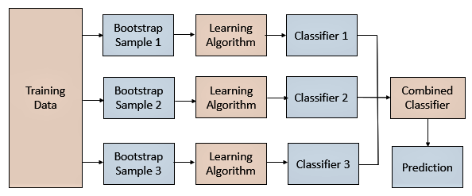
Bagging: Bootstrap Aggregation
Instead of running various models on a single dataset, you can use a single machine learning algorithm, almost always an unpruned decision tree, and train each model on a different sample of the same training dataset. The predictions made by the ensemble members are then combined using simple statistics, such as voting or averaging.
Notes:
Bagging, short for bootstrap aggregating.
Key to the method is the manner in which each sample of the dataset is prepared to train ensemble members. Each model gets its own unique sample of the dataset.
Examples (rows) are drawn from the dataset at random, although with replacement.
Random Forest is also an ensemble method.
Bagging involves Two steps:
1. Bootstrap sample set
2. Aggregation
Bagging or Bootstrap aggregation of sample data can be used for reducing the problem of overfitting and also variance. It is a special case of model averaging by generating additional data for model to learn most effectively from our original dataset using different combinations to produce multi-datasets of the same size as our original data.
Understand why bagging improves classification and regression performance

Slide 12
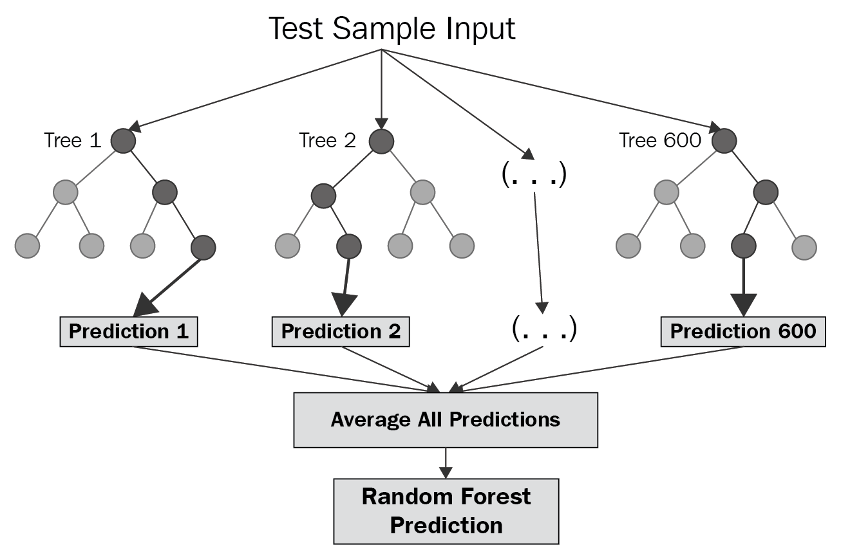
Random Forest = Row Sampling + Column Sampling
Random forest is an implementation of the bagging technique. You can see from its name; it creates a forest of the decision trees from randomly sampled data and combines them. So base learners in the random forest are decision trees.
Notes:
Random forest guarantees randomness to the model by feature bagging. Feature bagging means we select not all the features the base learners but we randomly sampled some of the features to train the base learners.
Random Forests performs Bagging internally. Random Forest creates several trees, sometimes thousands, and calculates the best possible model for a given dataset. Instead of considering all features while splitting a node, Random Forest algorithm selects the best feature out of a subset of all features.

Slide 13
Stacked Generalization, or stacking for short, is an ensemble method that involves fitting many different models' types on the same data and using another model to learn how to best combine the predictions.
Stacking has its own nomenclature where ensemble members are referred to as level-0 models and the model that is used to combine the predictions is referred to as a level-1 model.
Notes:
We can summarize the key elements of stacking as follows:
Unchanged training dataset.
Different machine learning algorithms for each ensemble member.
Machine learning model to learn how to best combine predictions
Any machine learning model can be used to aggregate the predictions, although it is common to use a linear model, such as linear regression for regression and logistic regression for binary classification.
Many popular ensemble algorithms are based on this approach, including:
Stacked Models (canonical stacking)
Blending
Super Ensemble

Slide 14
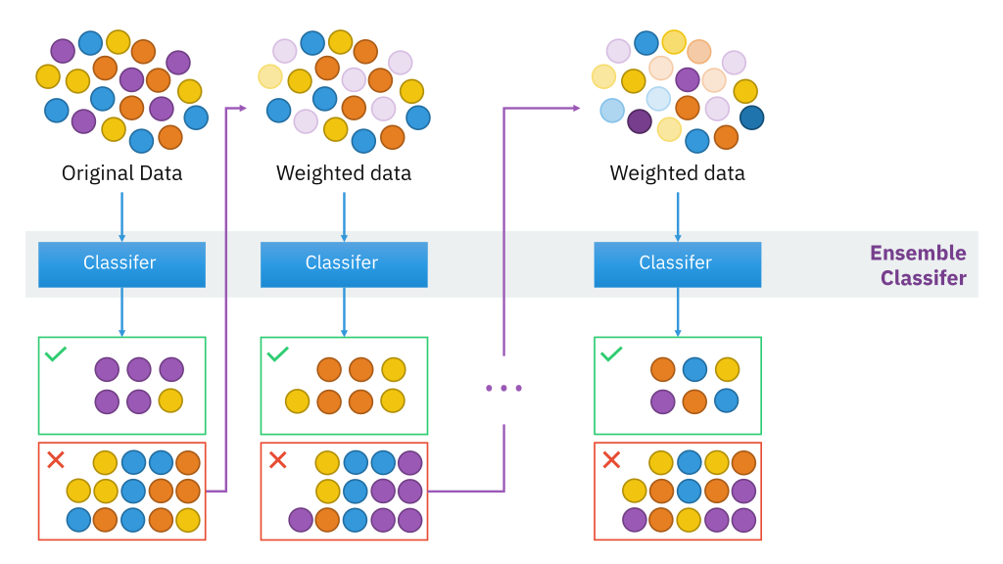
Boosting
Boosting in machine learning is an ensemble-based method used to boost the performance of weak learners.
Boosting trains models in succession, with each new model being trained to correct the errors made by the previous ones.
Notes:
In bagging, we assume that the base models will always give good results. But what if some of the data points are incorrectly classified? Combining such predictions will provide better results?
Such scenarios are taken care of by boosting.
Boosting is an iterative and sequential approach. It adaptively will change the distribution of the training data after each iteration. Initially, all the data points are considered equally likely for random sampling. And Rather than training all the models in isolation of one another, boosting trains models in succession, with each new model being trained to correct the errors made by the previous ones.
The key property of boosting ensembles is the idea of correcting prediction errors. The advantage of this iterative approach is that the new models being added are focused on correcting the mistakes which were caused by other models.
We can summarize the key elements of boosting as follows:
Bias training data toward those examples that are hard to predict.
Iteratively add ensemble members to correct predictions of prior models.
Combine predictions using a weighted average of models.
sequentially by putting more weight on instances with wrong predictions and high errors

Slide 15
Different types of boosting algorithms
AdaBoost (Adaptive Boosting)
Gradient Boosting Machines
Stochastic Gradient Boosting (XGBoost and similar)
Notes:
they are used for solving both classification and regression algorithms.
AdaBoost (canonical boosting)
Gradient Boosting Machines
Stochastic Gradient Boosting (XGBoost and similar)

Slide 16
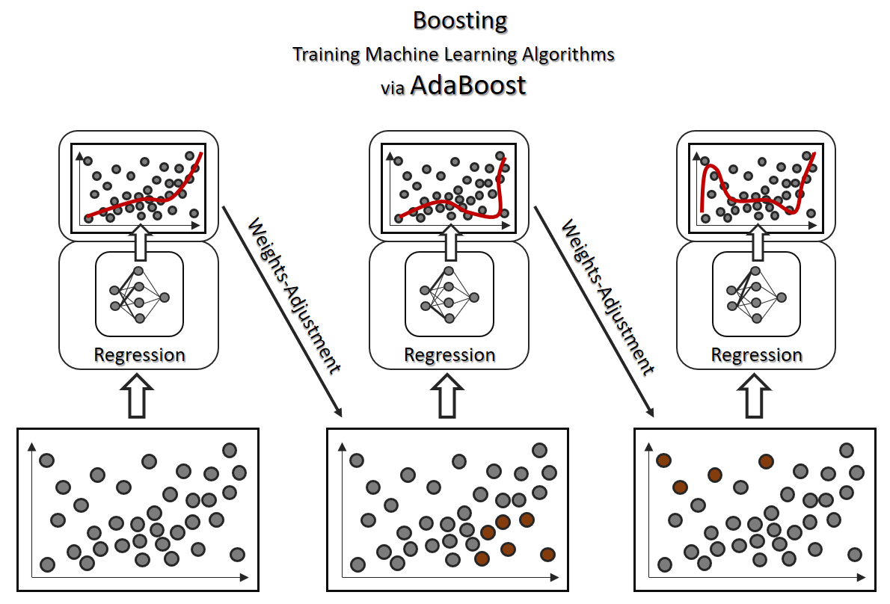
AdaBoost algorithm in Machine Learning
Instead of a Decision Tree, AdaBoost uses a decision stump which is a decision tree with tree maximum depth = 1.
Stumps that are created are not equally weighted in the final prediction. Stumps that create more error will have less say in the final decision.
The order in which the stumps are made is important, because each stump aims to reduce the errors that the previous stump(s) made.
Notes:
AdaBoost, short for Adaptive Boosting, is a machine learning meta-algorithm formulated by Yoav Freund and Robert Schapire, who won the 2003 Gödel Prize for their work. In simple terms, Adaboost runs a Classifier and make predictions. Run another classifier to fit the previously misclassified instances and make predictions. Repeat until all/most of the training instances are fitted.
AdaBoost is a boosting done on Decision stump. Instead of a Decision Tree, AdaBoost uses a Decision Stump which is a decision tree with max_depth = 1. that is a tree of single decision node and two leaf nodes.
The n_estimators parameters in AdaBoost sets the number of Decision Stumps.
First you select a base classifier which makes predictions on the given set. Note down the misclassified instances. The weights of the misclassified instances are increased. A second classifier is trained on the training set with updated weights.
A classic use case where AdaBoost algorithms is in the problem of Face Detection.
Gini impurity: Gini Impurity is a measurement of the likelihood of an incorrect classification of a new instance of a random variable, if that new instance were randomly classified according to the distribution of class labels from the data set.

Slide 17
Steps of Gradient Boost algorithm
Steps of Adaboost algorithm
Steps of Gradient Boost algorithm
Step 1: Assign a sample weight for each sample
Step 2: Calculate the Gini Impurity for each variable
Step 3: Calculate the Amount of Say for the stump that was created
Step 4: Calculate the new sample weights for the next stump
Step 5: Create a bootstrapped dataset with the odds of each sample being chosen based on their new sample weights.
Step 6: Repeat the process n number of times
https://towardsdatascience.com/a-mathematical-explanation-of-adaboost-4b0c20ce4382
Notes:
To keep it simple,
Fit a model to the given Training set. In each round of training, the weak learner is built and its predictions are compared to the correct outcome that we expect. The distance between prediction and truth represents the error rate of our model. These errors can now be used to calculate the gradient. Calculate the Residual Errors which become the new training instances. A new model is trained on these and so on. An addition of all the models is selected for making predictions.
The gradient basically the partial derivative of our loss function – so it describes the steepness of our error function. The gradient can be used to find the direction in which to change the model parameters in order to (maximally) reduce the error in the next round of training by “descending the gradient”.
These (GB) models suffer the problem of over-fitting if the data sample is too small. Whenever the training sample is large enough, you should try boosting..
You can read additional material at …..

Slide 18
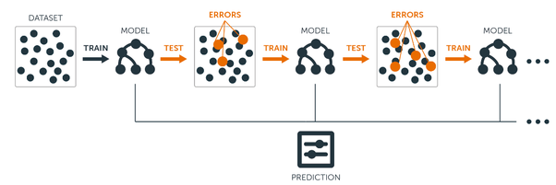
Gradient Boosting Machine
A machine learning technique for regression, classification and other tasks, which produces a prediction model in the form of an ensemble of weak prediction models, typically decision trees. It follows a loss function to minimize the error. BG aims to generate least residual as possible.
The guiding heuristic is that good predictive results can be obtained through increasingly refined approximations.

Slide 19
Steps of Gradient Boost algorithm
Step 1 : Assume mean is the prediction of all variables.
Step 2 : Calculate errors of each observation from the mean (latest prediction).
Step 3 : Find the variable that can split the errors perfectly and find the value for the split. This is assumed to be the latest prediction.
Step 4 : Calculate errors of each observation from the mean of both the sides of split (latest prediction).
Step 5 : Repeat the step 3 and 4 till the objective function maximizes/minimizes.
Step 6 : Take a weighted mean of all the classifiers to come up with the final model.
https://www.analyticsvidhya.com/blog/2015/05/boosting-algorithms-simplified/
Notes:
To keep it simple,
Fit a model to the given Training set. In each round of training, the weak learner is built and its predictions are compared to the correct outcome that we expect. The distance between prediction and truth represents the error rate of our model. These errors can now be used to calculate the gradient. Calculate the Residual Errors which become the new training instances. A new model is trained on these and so on. An addition of all the models is selected for making predictions.
The gradient basically the partial derivative of our loss function – so it describes the steepness of our error function. The gradient can be used to find the direction in which to change the model parameters in order to (maximally) reduce the error in the next round of training by “descending the gradient”.
These (GB) models suffer the problem of over-fitting if the data sample is too small. Whenever the training sample is large enough, you should try boosting..
You can read additional material at …..

Slide 20
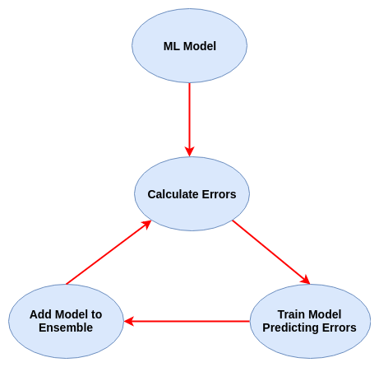
Gradient Boosting Machine
When a decision tree is the weak learner, the resulting algorithm is called gradient boosted trees, which usually outperforms random forest. Best used:
It can be used over regression when there is:
non-linearity in data
data is sparsely populated,
has low fill rate
basically, when regression is just unable to give expected results.
Diagram
Notes:
(do not say) GBM is a black box modeling technique with relatively complicated mathematics.
Gradient Boosting also works with successive predictive models added to the ensemble. Instead of updating the weights of the training instances like AdaBoost, Gradient Boosting fits the new model to the residual errors.
Similar to classifier boosters, we also have regression boosters. In these problems we have continuous variable to predict. This is commonly done using gradient boosting algorithm.
As many of machine learning algorithms have not capability to predict a certain variable. Hence they are considered weak learners.

Slide 21
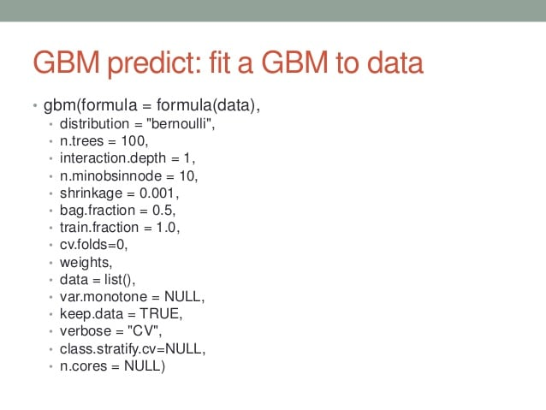
learning rate (the “step size” with which we descend the gradient)
shrinkage (reduction of the learning rate)
loss function
the number of iterations (i.e., the number of trees to ensemble)
the number of observations in each leaf
tree complexity and depth
the proportion of samples
the proportion of features on which to train on.

Slide 22
Hyperparameters of Gradient Boosting
learning rate (the “step size” with which we descend the gradient)
shrinkage (reduction of the learning rate)
loss function
the number of iterations (i.e., the number of trees to ensemble)
the number of observations in each leaf
tree complexity and depth
the proportion of samples
the proportion of features on which to train on.
Notes:
gradient is used to minimize a loss function,
Other hyperparameters of Gradient Boosting are similar to those of Random Forests:

Slide 23
Different Gradient Boosting implementations, you can use with caret R package.
Model | method Value | Type | Libraries | Tuning Parameters
Stochastic Gradient Boosting | gbm | Classification, Regression | gbm, plyr | n.trees, interaction.depth, shrinkage, n.minobsinnode
Gradient Boosting Machines | gbm_h2o | Classification, Regression | h2o | ntrees, max_depth, min_rows, learn_rate, col_sample_rate
eXtreme Gradient Boosting | xgbDART | Classification, Regression | xgboost, plyr | nrounds, max_depth, eta, gamma, subsample, colsample_bytree, rate_drop, skip_drop, min_child_weight
eXtreme Gradient Boosting | xgbLinear | Classification, Regression | xgboost | nrounds, lambda, alpha, eta
eXtreme Gradient Boosting | xgbTree | Classification, Regression | xgboost, plyr | nrounds, max_depth, eta, gamma, colsample_bytree, min_child_weight, subsample
Notes:
Three main forms of gradient boosting are supported:
Gradient Boosting
Stochastic Gradient Boosting: train each ensemble on a subset of the training set. Helps to improve generalizability of our model
Regularized Gradient Boosting
XGBoost: Is a specific implementation of the Gradient Boosting method which uses more accurate approximations to find the best tree model. The objective function contains loss function and a regularization term. It expresses the difference between actual values and predicted values, i.e., how far the model results are from the real values.
Since AdaBoost, many boosting methods have been developed and some, like stochastic gradient boosting, may be among the most effective techniques for classification and regression on tabular (structured) data.

Slide 24
eXtreme Boosting = Better speed + performance
It is decision tree-based ensemble machine learning algorithm.
In XGBoost we generally have decision tree sequentially. Hence this is called sequential ensemble technique.
Since XGBoost uses decision tree up to some depth than there will be high bias and low variance.
Very high in predictive power but relatively slow with implementation
XGBoost only works with numeric vectors
Need to transform data into a specific format that XGBoost can handle. That format is called DMatrix.
Define the parameters of the gradient boosting ensemble.
Notes:
extension of the classic gbm algorithm
linear model solver and tree learning algorithms
Let’s assign some weights to each record and these weights are similar to each other. The weights signify what probability to selected to be the decison tree for training process. Each decision tree will have its own sets of records after determining their probability. Afterwards decision tree will predict the dependent variable.
Now after predicting the variable, it will check with actual record that whether prediction is correct or not. If the prediction is wrong for a variable the weight assigned to that record will get updated. Hence this is called as weak classifier model. And after update they are feed to the decison tree model and predictions are generated again. If there are again wrong prediction weights are updated again for that record. And all this defining of model and generating prediction happens sequentially
Now at last we will have various classifiers and each will be called weak classifier.

Slide 25
Outline some of the more commonly used hyperparameters.
Parameter | Explanation
eta | default = 0.3 learning rate / shrinkage. Scales the contribution of each try by a factor of 0 < eta < 1
gamma | default = 0 minimum loss reduction needed to make another partition in a given tree. larger the value, the more conservative the tree will be (as it will need to make a bigger reduction to split) So, conservative in the sense of willingness to split.
max_depth | default = 6 max depth of each tree…
subsample | 1 (ie, no subsampling) fraction of training samples to use in each “boosting iteration”
colsample_bytree | default = 1 (ie, no sampling) Fraction of columns to be used when constructing each tree. This is an idea used in RandomForests
min_child_weight | default = 1 This is the minimum number of instances that have to been in a node. It’s a regularization parameter So, if it’s set to 10, each leaf has to have at least 10 instances assigned to it. The higher the value, the more conservative the tree will be.
Full reference: https://xgboost.readthedocs.io/en/latest/parameter.html

Slide 26
With this guide, you discovered the three standard ensemble learning techniques for machine learning and how to code this algorithms in the R programming language. Specifically, you learned:
Bagging involves fitting many decision trees on different samples of the same dataset and averaging the predictions.
Stacking involves fitting many different models, types on the same data and using another model to learn how to best combine the predictions.
Boosting involves adding ensemble members sequentially that correct the predictions made by prior models and outputs a weighted average of the predictions.

